Slide 1



Carbon Emission Tracker
Team members:
Amruta Naik
Prathush Pillai
Zehao Song

Slide 2


The Carbon Emission Tracker is a web application designed to collect, analyze, and display data on carbon emissions, focusing on various travel types and actions that contribute to greenhouse gas emissions. Users can sign up, explore educational content, upload data ,view visual representations of emissions data and participate in events aimed at raising awareness and mitigating carbon footprints.
PURPOSE

Slide 3











TECH STACK

Slide 4
Bcrypt: Used for encrypting user-entered passwords.
JWT (JSON Web Token): Used in User Sign in for authentication purposes.
Express: Although not explicitly stated as an external library, Express is an external library/framework used for routing and middleware in Node.js applications.
Mongoose: Easier development for MongoDB, Mongoose is an external library used for MongoDB object modeling.
Axios: An external HTTP client used for handling HTTP requests to REST endpoints.
Formik: A form library that helps with form creation and submission in React applications.
Yup: Used to create a validation schema for each form component, Yup is an external library for data schema validation.
Material UI: A graphical implementation of client-side web applications, Material UI is an external library for UI components in React applications.
JWT-Decode: Used to decode the token received from the server-side for user ID, JWT-Decode is an external library for decoding JWT tokens.
Recharts: Used to visualize user data, Recharts is an external library for creating charts in React applications.
JsPDF: Used to create custom user data PDFs, JsPDF is an external library for generating PDF documents in JavaScript.
CORS (Cross-Origin Resource Sharing) is a security feature implemented by web browsers to control how web pages from one origin can access resources from another origin
Libraries used

Slide 5
Some of the features for our app:
CRUD Profiles
Search for events
View Events
Register for Events
Subscribe for Newsletter
Internationalization in UI
User Authentication
Interactive User Interface
Data Collection and Visualization
PDF download
FEATURES

Slide 6
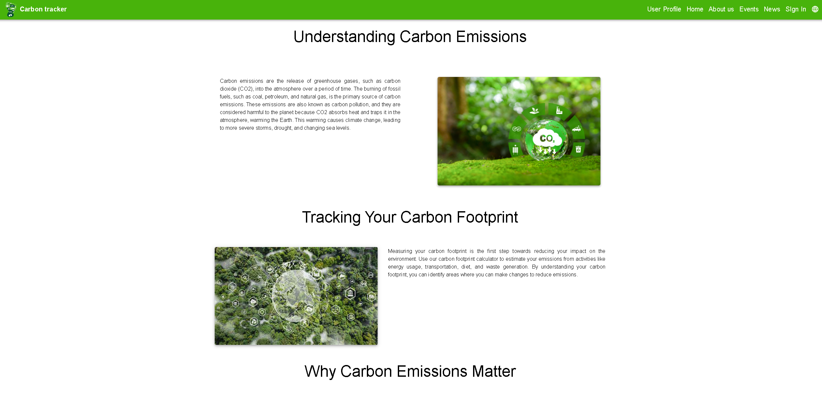
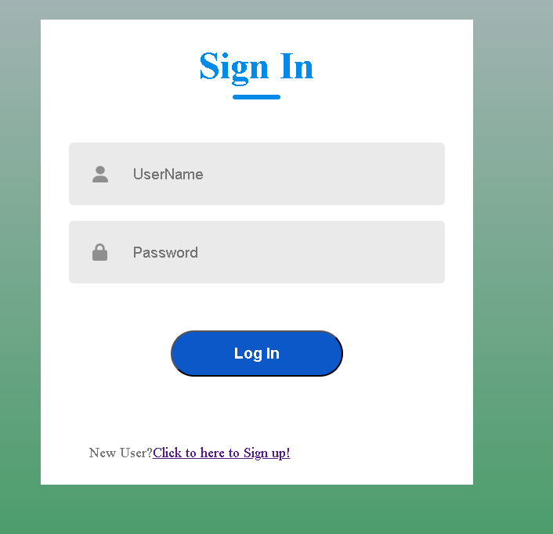
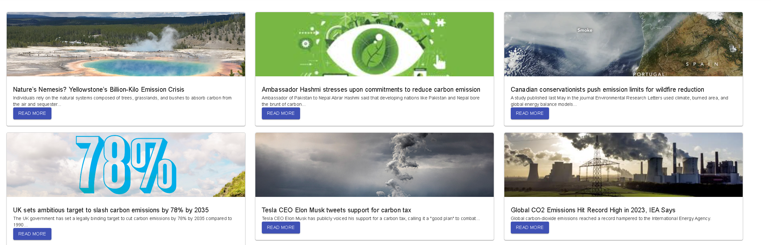
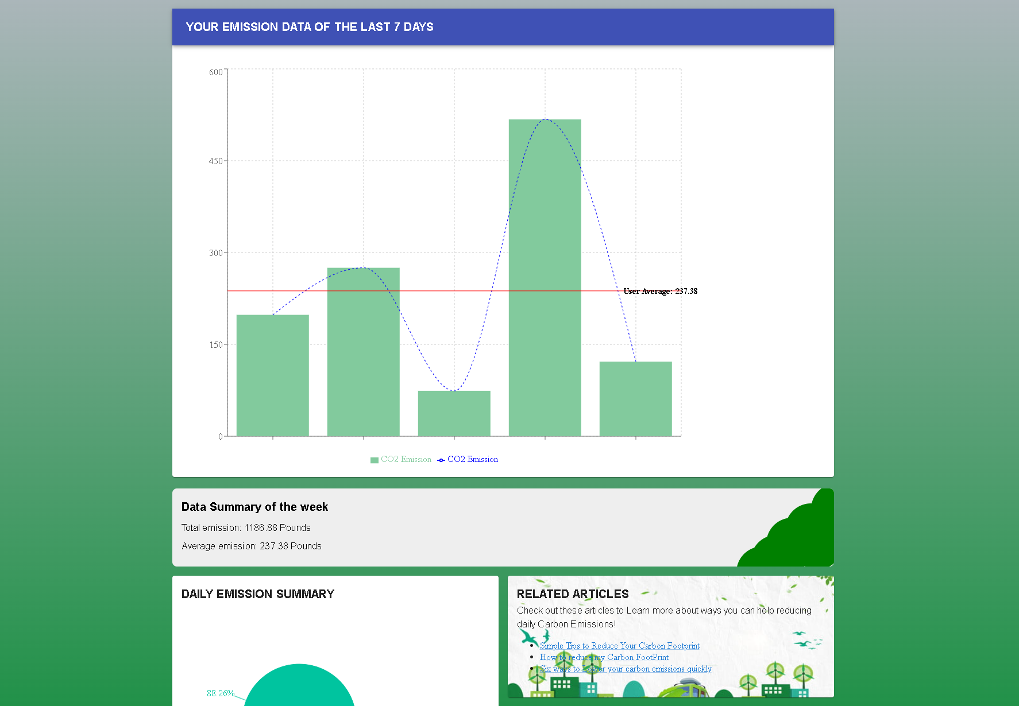
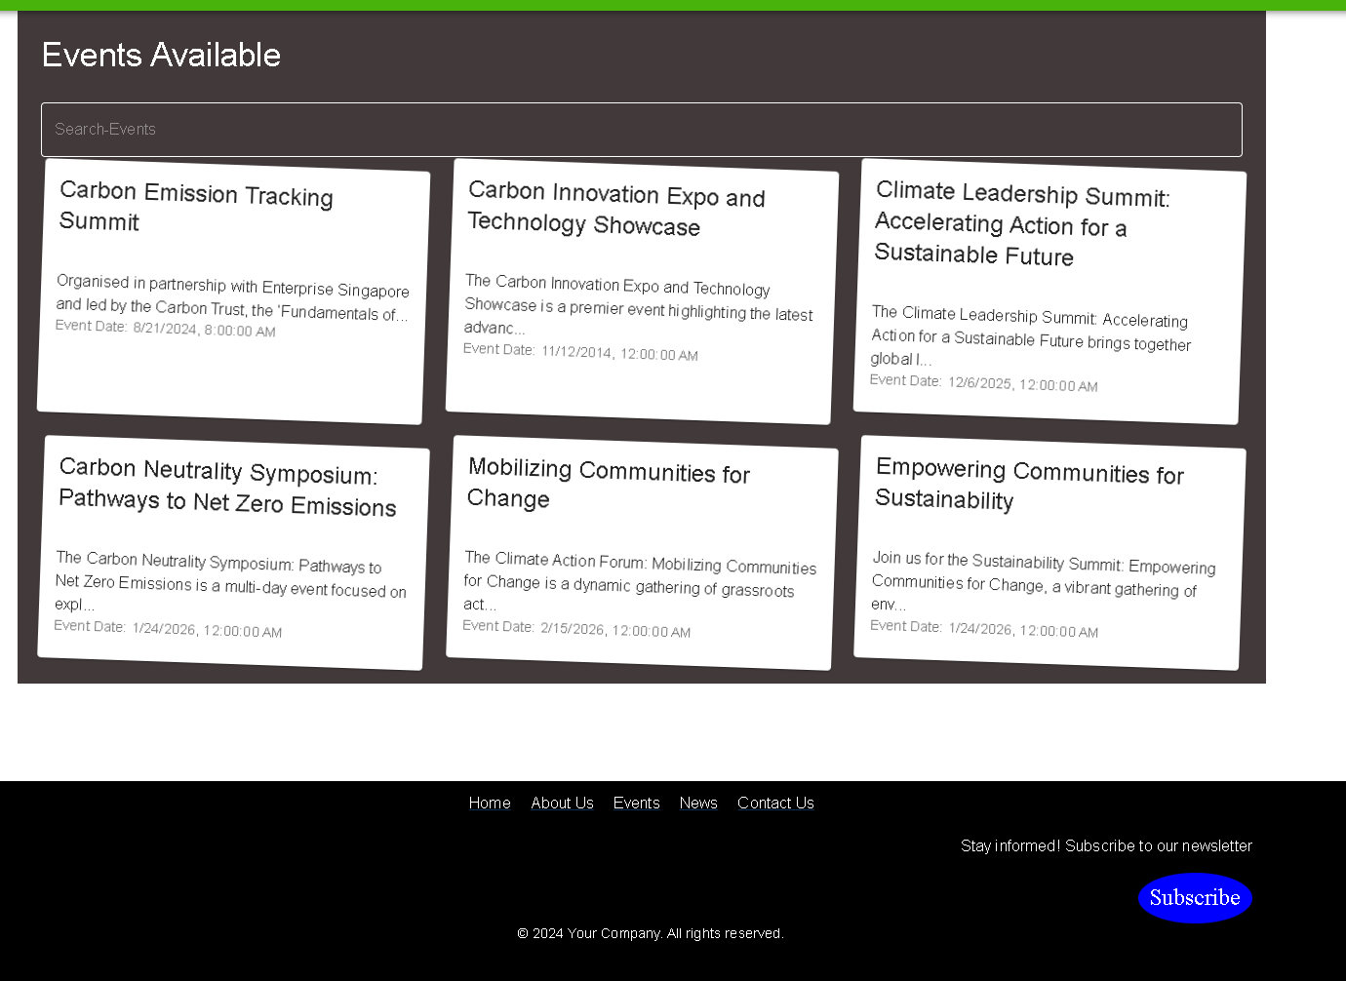
Screen Shots

